Slide 1
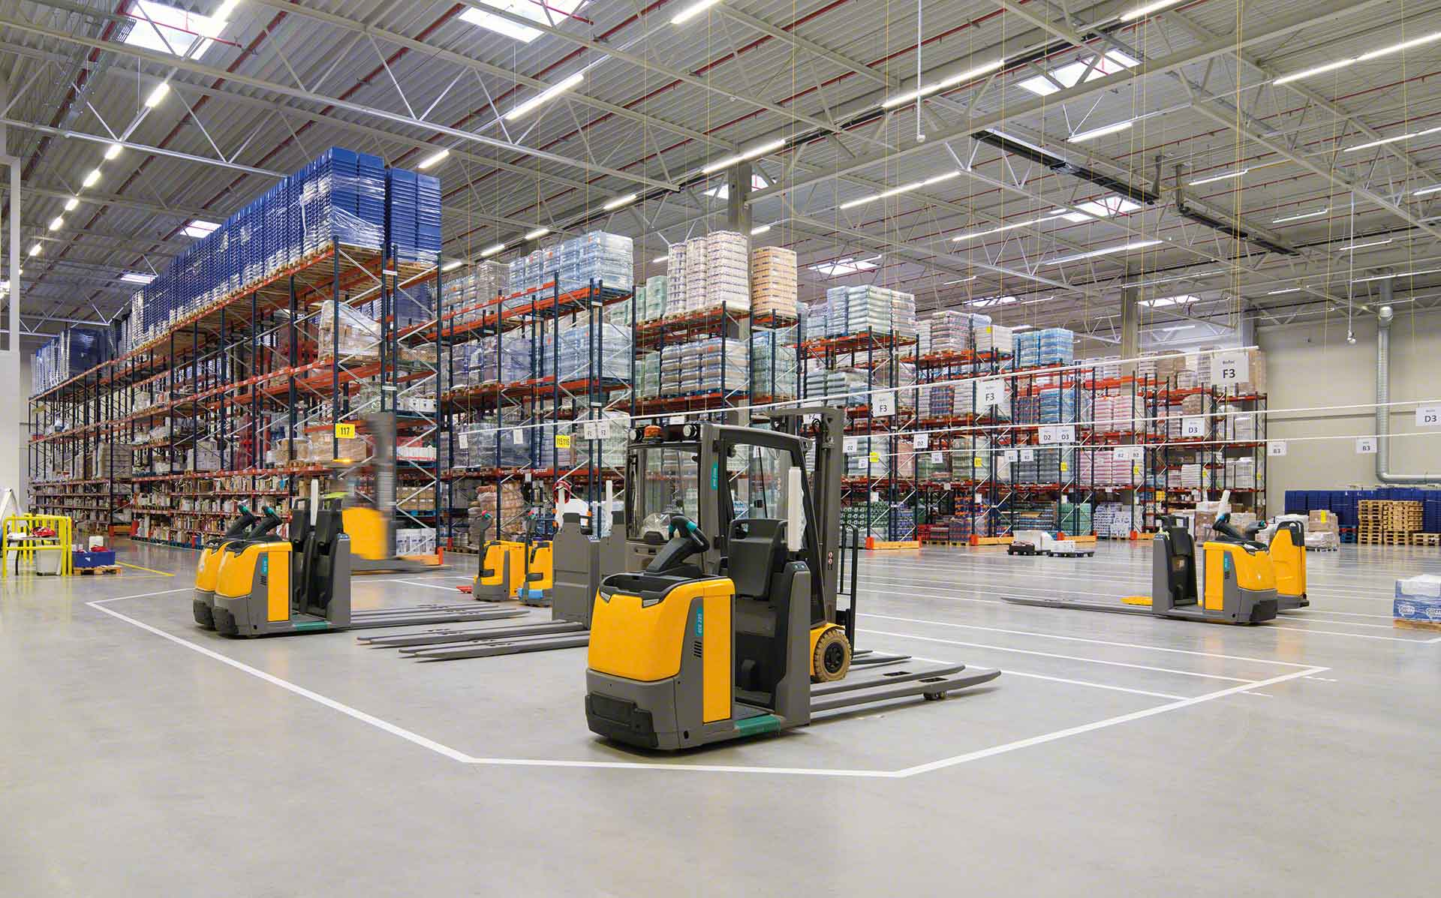

Material Handling KPI
Semana 4 septiembre 2022

Slide 2
Movements September
Row Labels | Sum of MAT HANDLE | Sum of CYCLE COUNTS
erojas | 973 | 1
judelato | 902 | 0
jtobias | 637 | 15
jodelacr | 572 | 17
Grand Total | 3084 | 33
Row Labels | Sum of CYCLE COUNTS | Sum of MAT HANDLE | Sum of cc MH
judelato | 3 | 1362 | 1365
erojas | 3 | 1033 | 1036
jtobias | 22 | 853 | 875
jodelacr | 42 | 823 | 865
amiranda | 0 | 302 | 302
Grand Total | 70 | 4373 | 4443

Slide 3
Adjustments
Row Labels | Sum of COST | Count of PART
jtobias | -1775.81 | 21
erojas | -68.84 | 1
judelato | 280.02 | 2
jodelacr | 2572.94 | 27
Grand Total | 1008.31 | 51
Row Labels | Sum of COST | Count of PART
jodelacr | -$391.33 | 34
judelato | -$25.99 | 1
erojas | $111.30 | 2
jtobias | $990.12 | 17
Grand Total | $684.10 | 54

Slide 4
Labor intensive
Class not slotted count
23
Labor Intensive
51

Slide 5
rESTOCK
Part Numbers stocked
1783
Part Numbers stocked
1276

Slide 6
Empty locations
Row Labels | Sum of Total de espacios disponibles | Sum of Empty Loc | Sum of Empty Loc Bulky
Jul | 316 | 269 | 47
Aug | 1586 | 1361 | 225
Sep | 623 | 446 | 177
Grand Total | 2525 | 2076 | 449

Slide 7
Discrepancies
Fecha | 29 Agosto- 2 Septiembre | 5 - 9 Septiembre | 12- 16 Septiembre | 19-23 Septiembre | 26-30 Septiembre
Locacion | 800126 | 840374 | 840374 | 840374 | 810085
 | 810015 | 850385 | 850385 | 840383 | 830203
 | 810135 | 880171 | 850351 | 850385 | 840306
 | 830061 | 880382 | 860361 | 880171 | 840374
 | 840277 | 890391 | 870437 | 890391 | 840383
 | 840221 | 910031 | 880171 | 910051 | 860231
 | 860126 | 910051 | 880382 | 910063 | 860456
 | 860165 | 910063 | 890391 | 910121 | 870062
 | 870135 | 910121 | 910051 | 910161 | 890391
 | 870233 | 910161 | 910063 | 910223 | 910051
 | 880071 | 910171 | 910121 |  | 910063
 | 880277 | 910172 | 910161 |  | 910121
 | 890302 | 910223 | 910172 |  | 910223
 | 890352 | 910231 | 910223
 | 890391 | 910261 | 910231
 | 910031
 | 910051
 | 910063
 | 910121
 | 910161
 | 910171
 | 910172
 | 910223
 | 910231
 | 910261

Slide 8
Consolidation
Part Number | Sum of Count of Location beginning of August | Sum of Count loc end August
13105 | 58 | 77
33074 | 35 | 32
1017223 | 34 | 24
922442964 | 32 | 22
0509999 | 30 | 29
13210 | 24 | 21
32446 | 24 | 23
13361 | 23 | 14
111024793 | 21 | 21
13005 | 21 | 14
13109 | 21 | 21
1017222 | 20 | 18
1054269V01 | 19 | 19
33215 | 18 | 14
33078 | 17 | 21
0169778 | 17 | 13
13209 | 16 | 15
13103 | 16 | 11
111024794 | 15 | 11
95109 | 14 | 11
12107 | 14 | 9
13055 | 13 | 9
95209 | 13 | 8
1050069 | 13 | 6
37018 | 12 | 11
13003 | 11 | 12
36554 | 11 | 10
921980126 | 11 | 10
1305727 | 11 | 10
1024818 | 10 | 9
1054269 | 10 | 7
1054267V01 | 10 | 8
Grand Total | 614 | 540
free locations 16

